Slide 1
Introduction to
Programming
CSC10001

Slide 2
Lecturer
TS. Châu Thành Đức
ThS. Đậu Ngọc Hà Dương
Theory: 45 credit hours
Practice: 30 credit hours
Self-Study: 90 credit hours

Slide 3
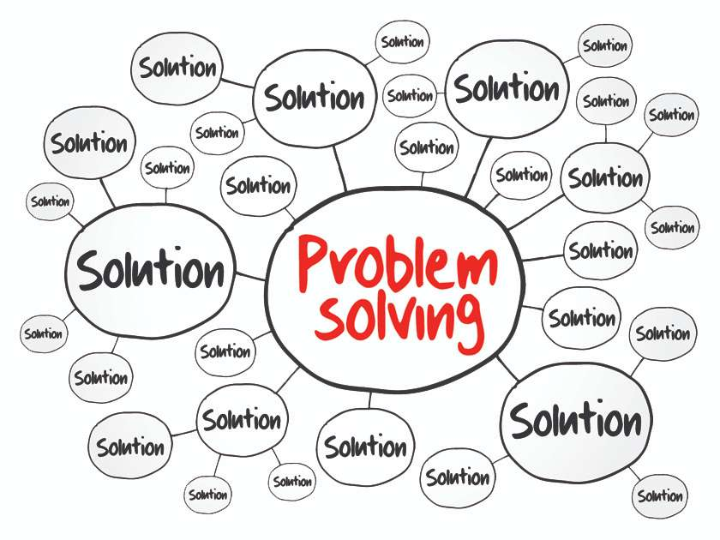

Slide 4
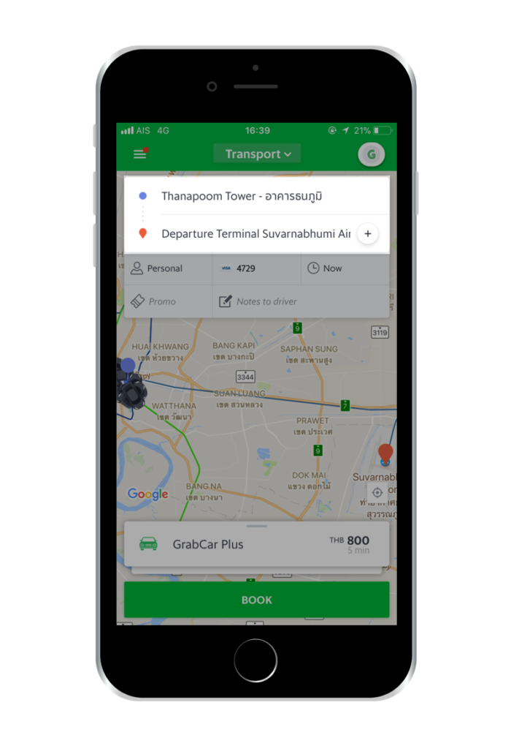
Can you solve it?

Slide 5
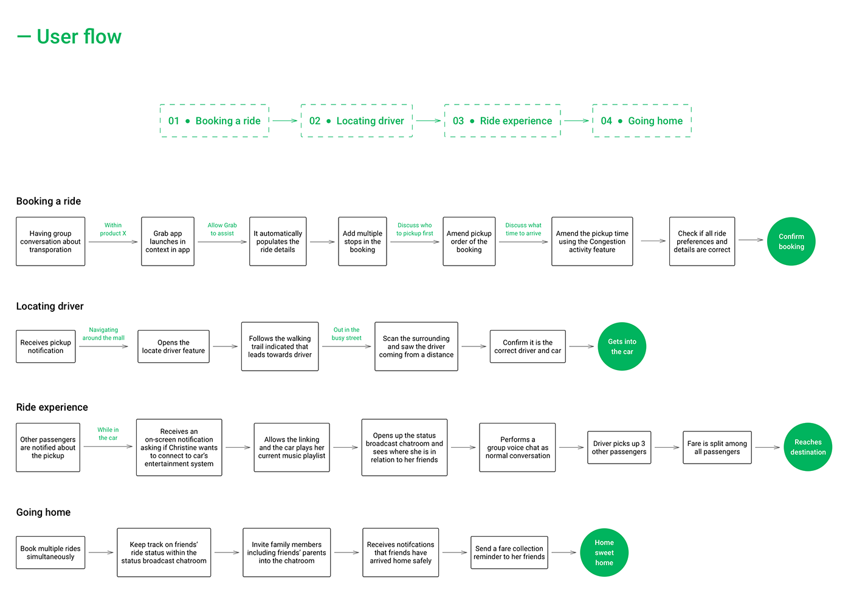
Notes:
How many problems that Grab have to solve to make a successful ride

Slide 6
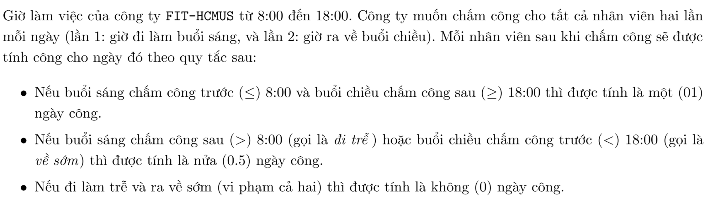
Can you solve it?

Slide 7
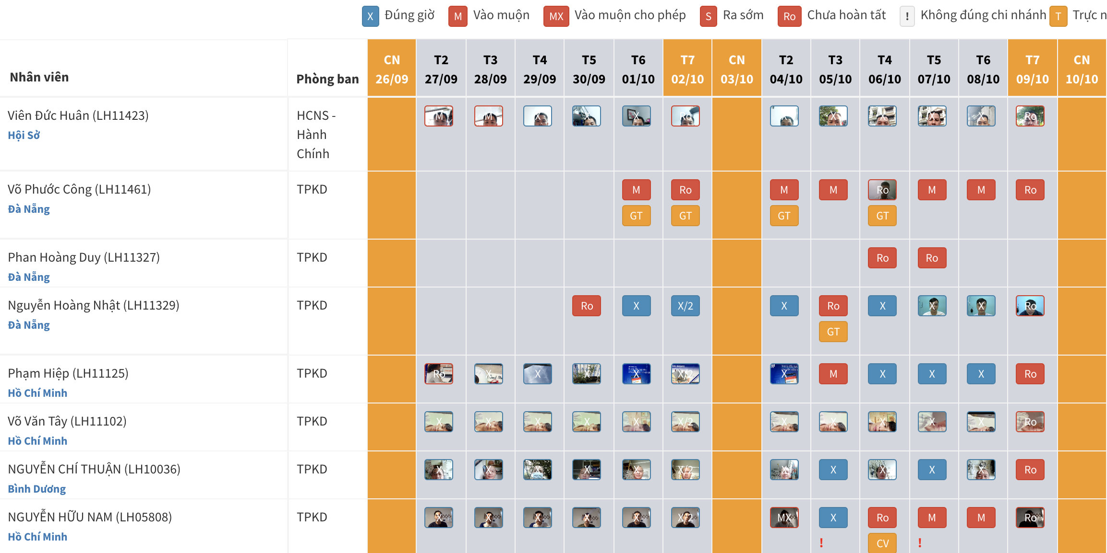
Can you solve it?

Slide 8
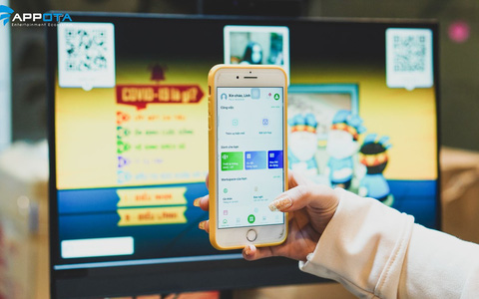
Can you solve it?

Slide 9
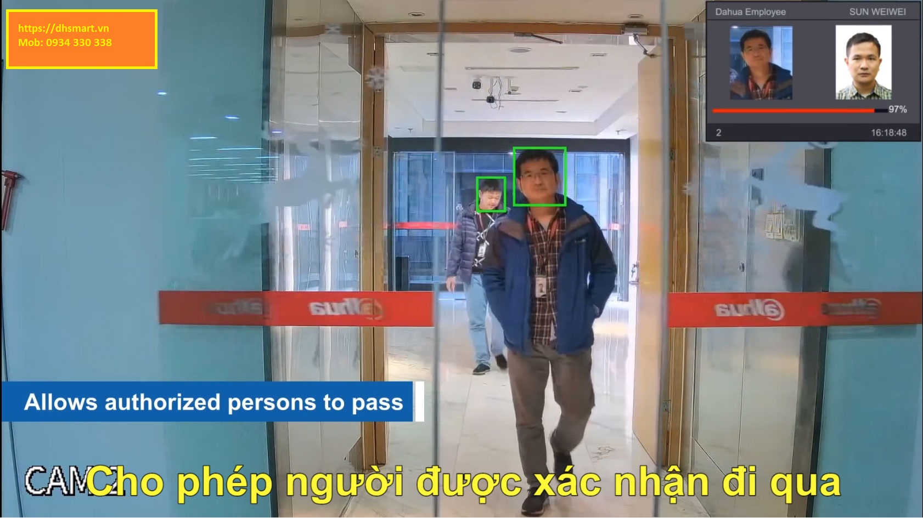
Can you solve it?

Slide 10

Can you solve it?

Slide 11



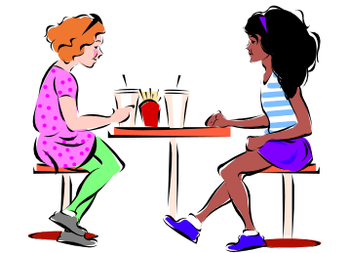
The Programming Approach to Solving Problems
Classroom
Algorithm is a set of steps that are performed to solve a problem. The example below describes an algorithm
Leaving the
classroom
Head towards
the staircase
Go to the
basement
Head for the
cafeteria
These are the steps followed when a student wants to go to the cafeteria from the classroom
Cafeteria

Slide 12
Solving a Problem
In order to solve a problem
Understand the problem clearly
Gather the relevant information
Process the information
Arrive at the solution

Slide 13

Q & A

